Slide 1

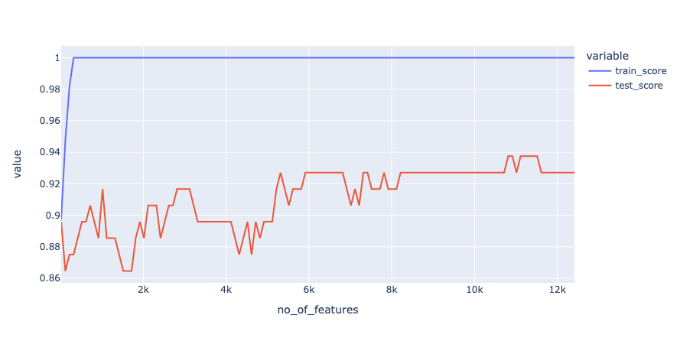
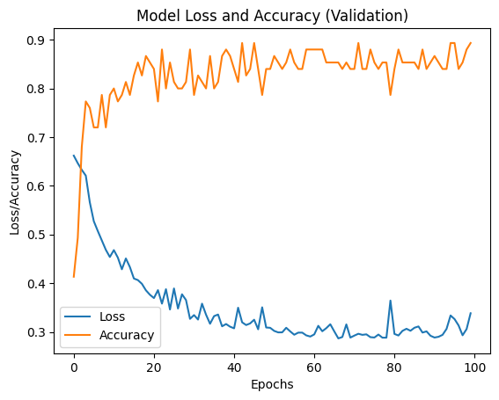
Early Detection of Alzheimer’s using Blood Gene Expression Data AND machine learning algorithm
Hariharan J (22MCB1006) Guided by Dr. R Jothi
2023
School of Computer Science and Engineering
INDUSTRY CONCLAVE 2023
INTRODUCTION
Alzheimer’s disease (AD) is a progressive neurological disorder categorized by the gradual loss of cognitive function and memory.
Most common cause of dementia among older adults.
Expected to grow to 11,422,692 by 2050 from 3,848,118 measured in 2019.
Currently no cure for AD and available treatments only offer temporary symptom relief.
Early detection and diagnosis of AD is crucial for the planning of appropriate care and support for individuals and their families, as well as for the development of disease-modifying therapies. However, current diagnostic methods for AD often involve invasive and expensive procedures, such as brain imaging or lumbar punctures. Proposed model focuses on solving this using a less invasive and cost-effective method of identification of specific gene expression (GE) patterns in the blood that are associated with AD may enable the development of simple and reliable diagnostic tools that can be used in a clinical setting
Objectives
Primary objective is to find the best algorithm to extract the genes from blood gene expression that influence the possibility of Alzheimer’s.
Secondary objective is to find the best algorithm which can classify using the DEG the possibility of Alzheimer’s.
SCOPE of the project
The project aims to understand the underlying mechanisms of Alzheimer's disease through potential Biomarkers from GE.
methodology
Data Preprocessing : Integration of samples from different sources to overcome the problem of overfitting due to less sample size. Post integration the values are normalized.
Feature Selection: Optimum subset of gene symbols filtered out to address the high dimensionality problem using statistical and ML methods (ANOVA + SVM).
Data Augmentation: GAN technique to augment the data points closer to the data points in the actual sample.
Classification: Deep CNN’s models are used to classify AD samples from healthy samples (CTL).
Architecture
Dataset: 3 datasets GSE63060, GSE63061 and ADNI, on total 1148 samples each with a maximum of 49,386 gene symbols.
Feature Selection: ANOVA and SVM modules of sklearn package in python used.
Data Augmentation: TABGAN package of python used to generate the augmented samples.
Classifier: Deep CNN model designed using TensorFlow framework.
Visualization: Matplotlib package is used to visualize the results of model.
Results
Conclusion
Multiple feature selection approaches were explored on the dataset created by integrating datasets from multiple sources to identify the optimal genes that could be potential biomarkers for AD classification, and it was discovered that using the top 10814 genes extracted using ANOVA + SVM had a significant impact on the classification model's accuracy. Before sending the samples for deep CNN-based classification, GAN-based data augmentation was also performed to reduce overfitting due to small sample size. Maximum accuracy of 93.7% was observed for the proposed system, proving that the proposed blood gene expression-based AD classification technique is comparable to current MRI-based methods.
References
[1] Lee, T., Lee, H. Prediction of Alzheimer’s disease using blood gene expression data. Sci Rep 10, 3485, 2020. https://doi.org/10.1038/s41598-020-60595-1.
[2] C. Park, J. Ha, and S. Park, "Prediction of Alzheimer's disease based on deep neural network by integrating gene expression and DNA methylation dataset," Expert Systems with Applications, vol. 140, pp. 112873, 2020, doi: 10.1016/j.eswa.2019.112873.
Model | Accuracy
Existing | 92.9%
Proposed with DA and 10814 features | 93.7%
Datasets
Integration
Feature Selection
AD or CTL
Machine Learning Classifiers
Data Augmentation

